Slide 1



Database Systems
Sambhav SHARMA
20017811
DataBase Design and Development CA-2

Slide 2

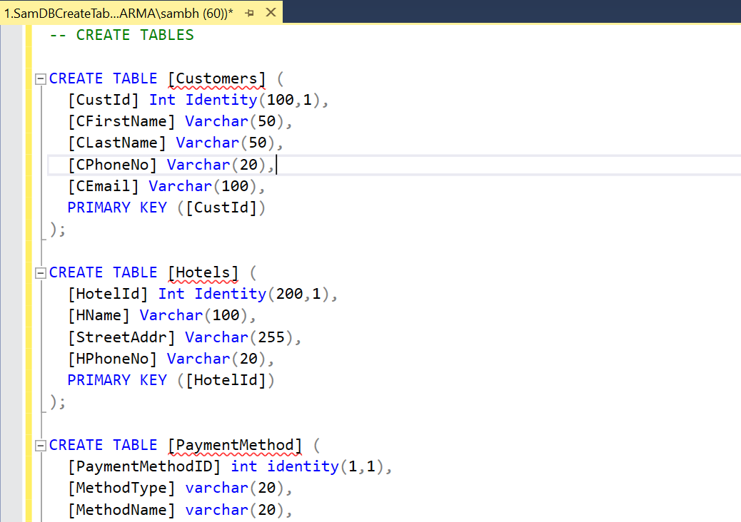
Create the relevant tables with appropriate relationships in MS SQL Server using the CREATE TABLE statement!!

Slide 3

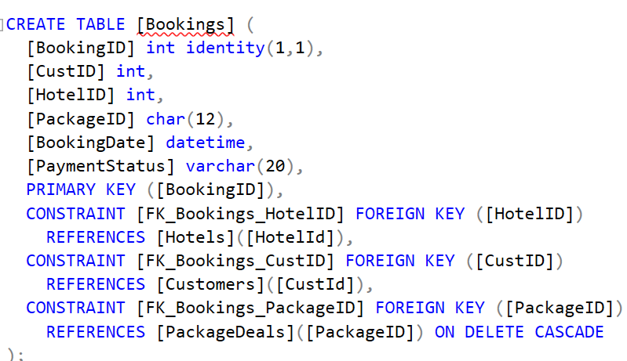
Utilise the CASCADE on DELETE command to facilitate the Delete Proc outlined below!!

Slide 4

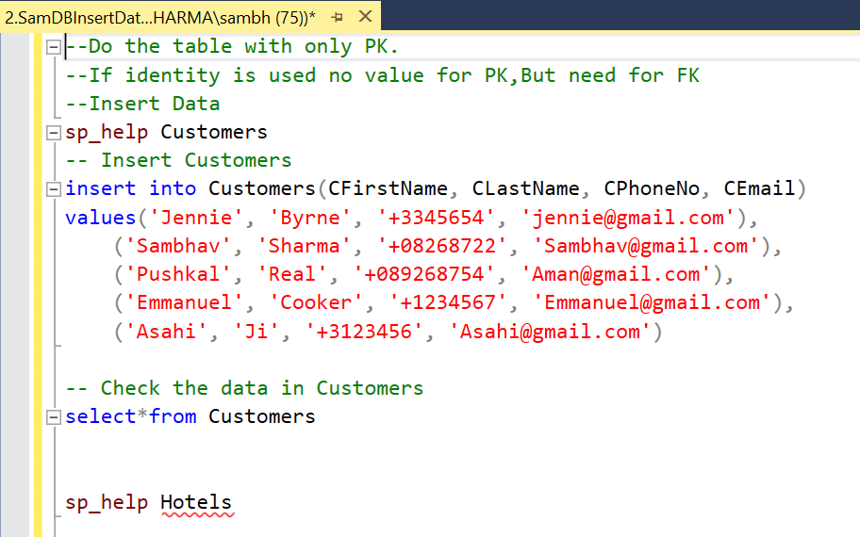
Populate the tables with a minimum of 5 records using INSERT INTO SQL Statements!!

Slide 5

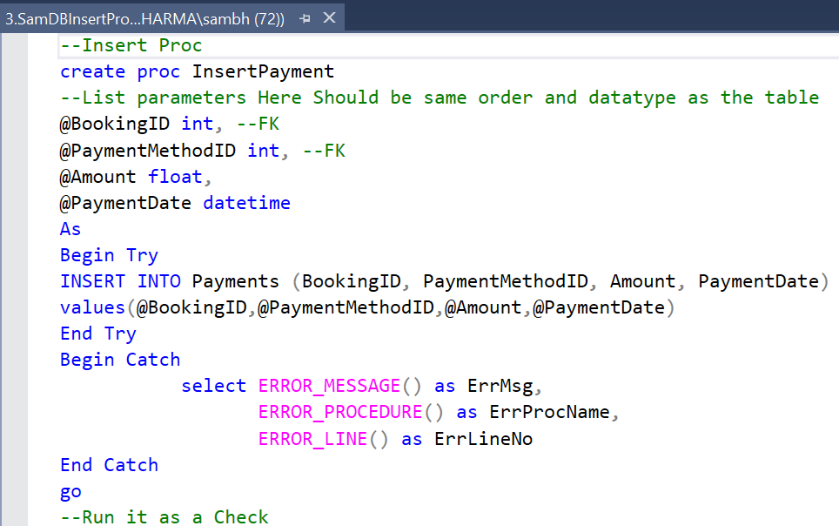
Create the following Parametric stored procedures!!

Slide 6
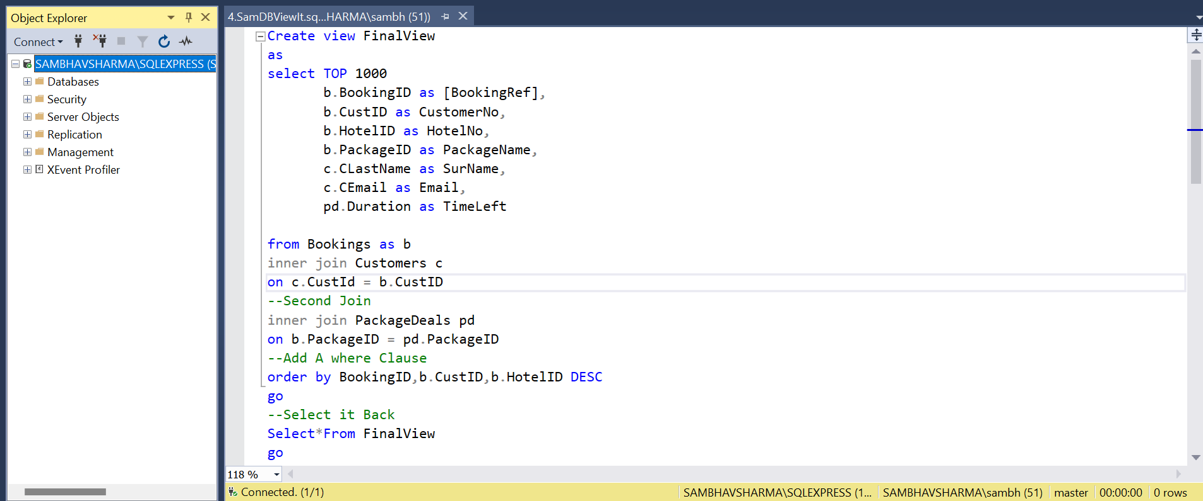
Create 1 View that would be beneficial for the business. This View should consist of!!

